Slide 1
SPI-to-Ethernet

Slide 2
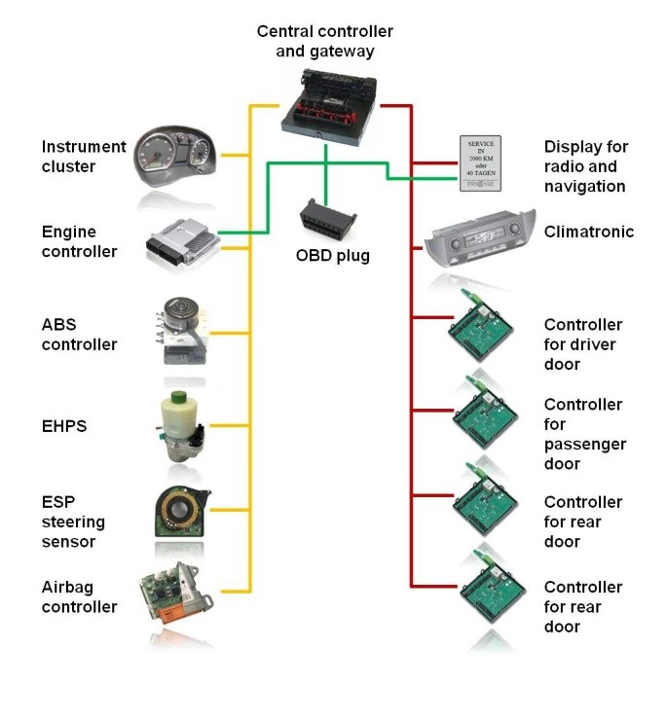
Objective
The objective of this task to figure out a way for transmitting the data from the sensors to the main ECU (raspberry pi)
At the beginning we were planning to use CAN protocol for transferring the data
But at the end we sticked with the ethernet approach for transferring the data.

Slide 3
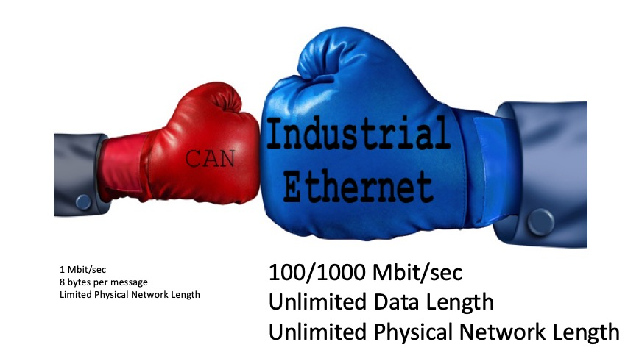
Why Ethernet?
We have chosen ethernet approach instead of can bus for several reasons.
Ethernet provides faster transmission speed (10/100 Mbit/sec compared to CAN's 1 Mbit/sec at minimal network length)
combined with a virtually unlimited amount of data (CAN Bus is limited to 8 bytes per data frame)
Valeo recommended us to use Ethernet instead of CAN protocol

Slide 4
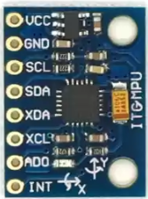
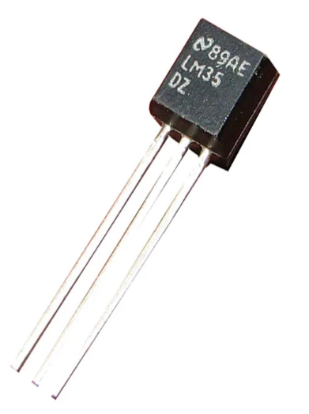
Sensors
According to our current plan we are planning to use these sensors (this plan may change in the future):
Temperature sensor
IMU sensor
Speed sensor
Brake sensor

Slide 5
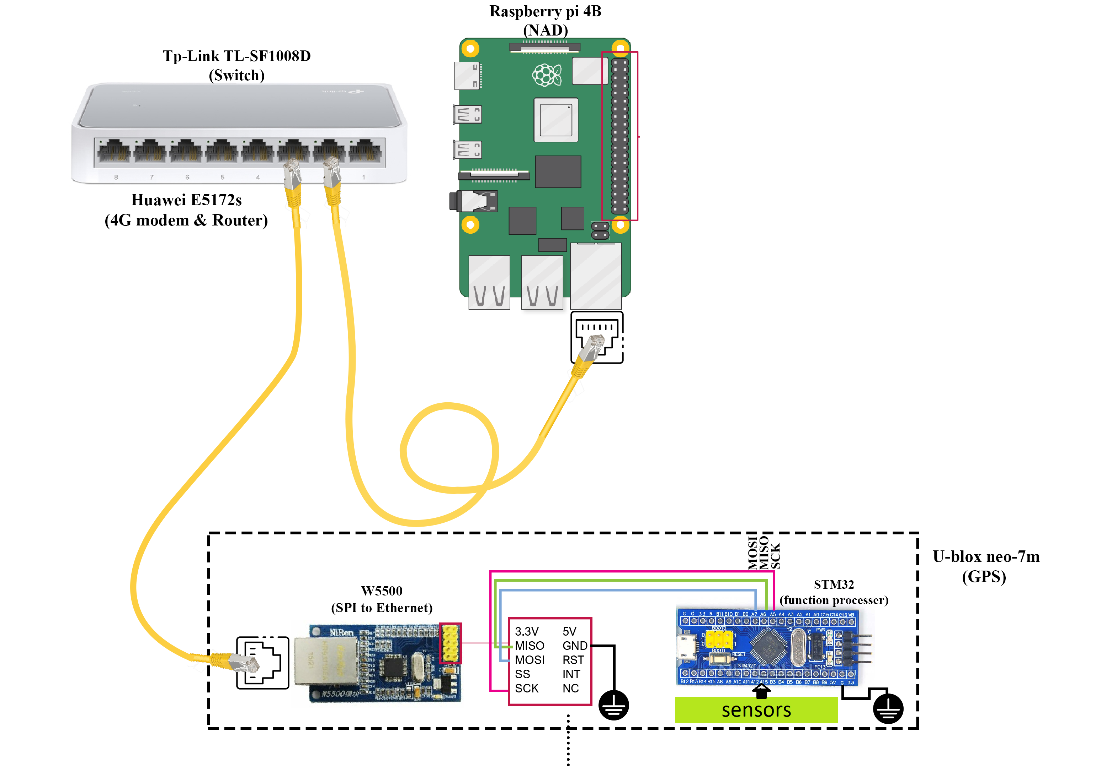
Ethernet connection
The network consists of nodes, main ECU (raspberry pi) and switch
The nodes and the main ECU are connected to a central point (switch)
Using this connection nodes which contains the data is capable of forwarding the packets to the main ECU (raspberry pi)

Slide 6
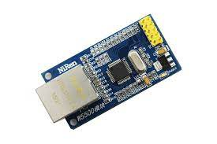
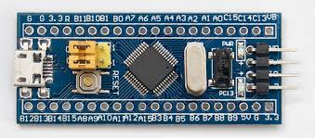
Components for a Node
Each node consists of:
W5500 (SPI-to-Ethernet module)
STM32
Specific sensors to be interfaced with STM32

Slide 7
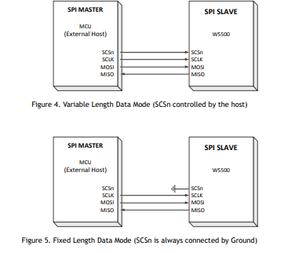
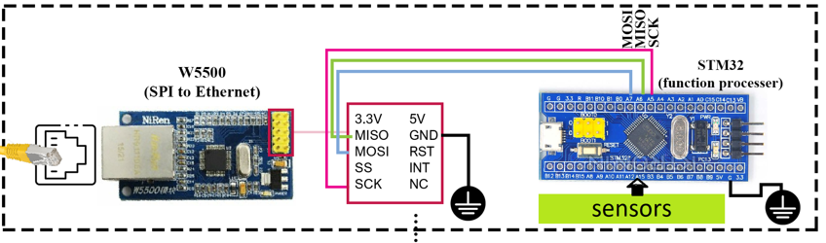
Node connection
The STM32 communicates with W5500 via SPI
The STM32 is the master where it sends commands or instructions in order to control W5500.
The W5500 is the slave where it listens to the commands or instruction sent by the STM32 and executes the ordered commands.
We are utilizing the variable length data mode

Slide 8
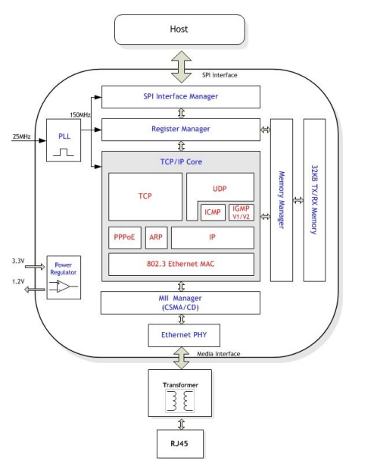
Layers of W5500
The W5500 consists of there four layers:
First layer is the SPI interface layer where the STM32 is interfaced with W5500 using SPI to be able to send commands through SPI
Second layer is the register manager where it takes the information sent by the STM32 and place it in the appropriate register location for configuring the W5500.
Third layer is the memory manager where it takes the information sent by the STM32 and place it in the appropriate memory location for configuring the W5500.
Four layer is TCP/IP layer, the W5500 has TCP/IP stack already implemented, so no need to reimplement TCP/IP stack.

Slide 9
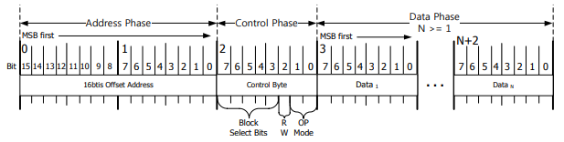
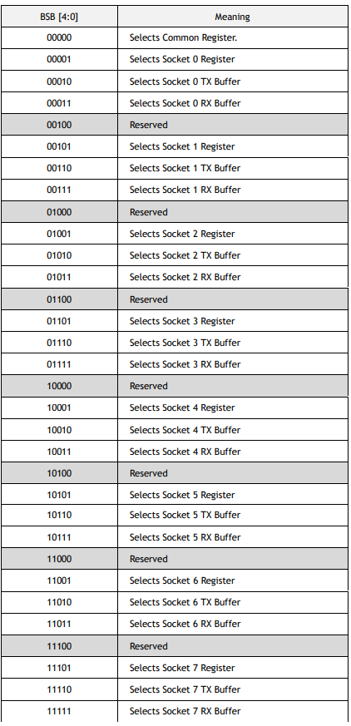
W5500 SPI frame format
W5500 consists of a common register and eight different socket registers.
W5500 SPI Frame consists of 16bits Offset Address in Address Phase, 8bits Control Phase and N bytes Data Phase
This Address Phase specifies the 16 bits Offset Address for the W5500 Registers and TX/RX Buffer Blocks. The 16-bit Offset Address value is transferred from MSB to LSB sequentially
Block Select bits select the block to which the Offset Address belongs

Slide 10
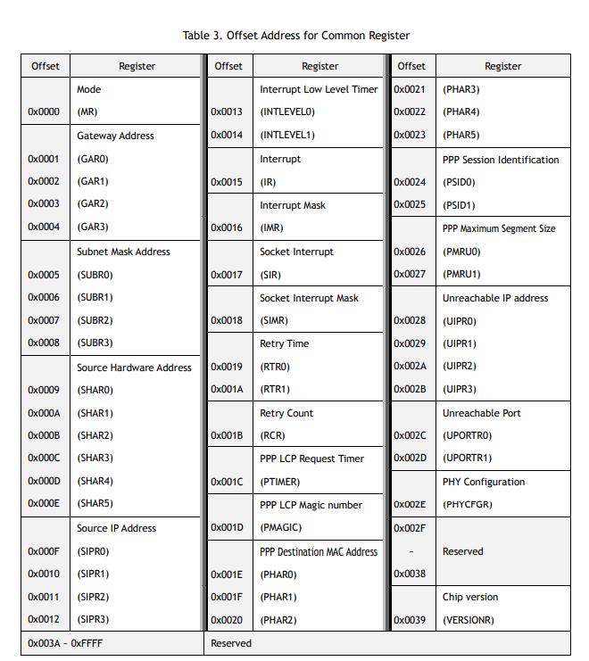
Common register
Common Register Block configures the general information of W5500 such as IP and MAC address

Slide 11
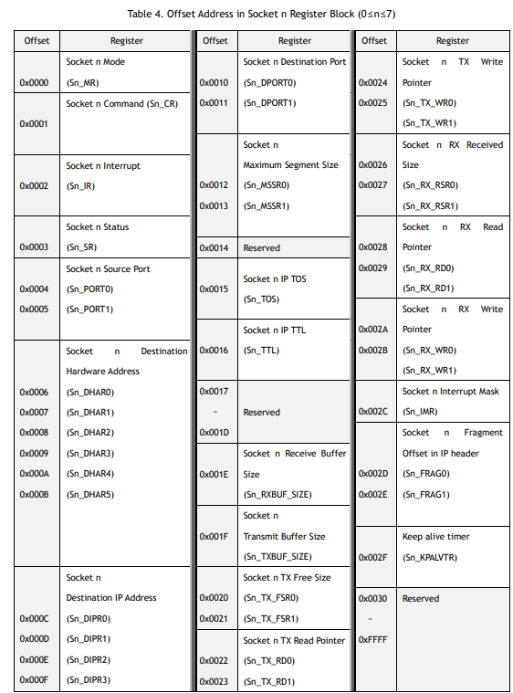
Socket register
W5500 supports 8 Sockets for communication channel.
Each Socket is controlled by Socket n Register Block(when 0≤n≤7)

Slide 12
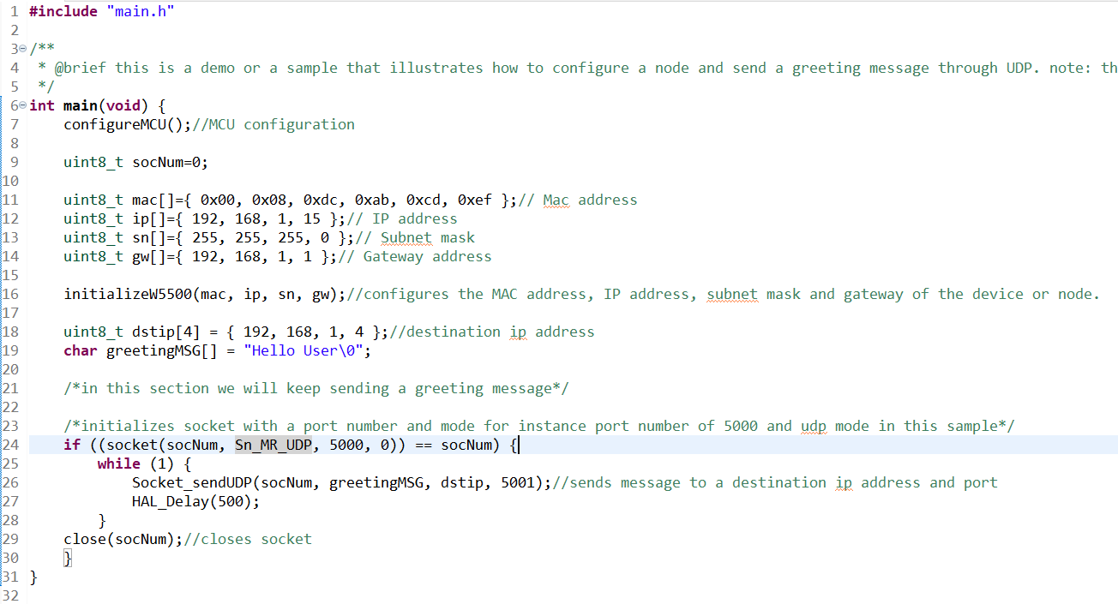
Configuring W5500
We have implemented API’s or functions for our team to make it easier to configure the W5500

Slide 13
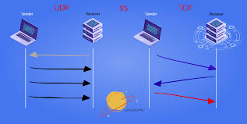
Why UDP?
UDP is chosen rather than TCP. It allows data transmission to begin faster without delays or extended latency time. There is also no need to put the packets in sequence or send and receive acknowledgments, saving time. In addition to latency, UDP is also more efficient in terms of bandwidth. These are the features that are required since we are using real-time data.

Slide 14
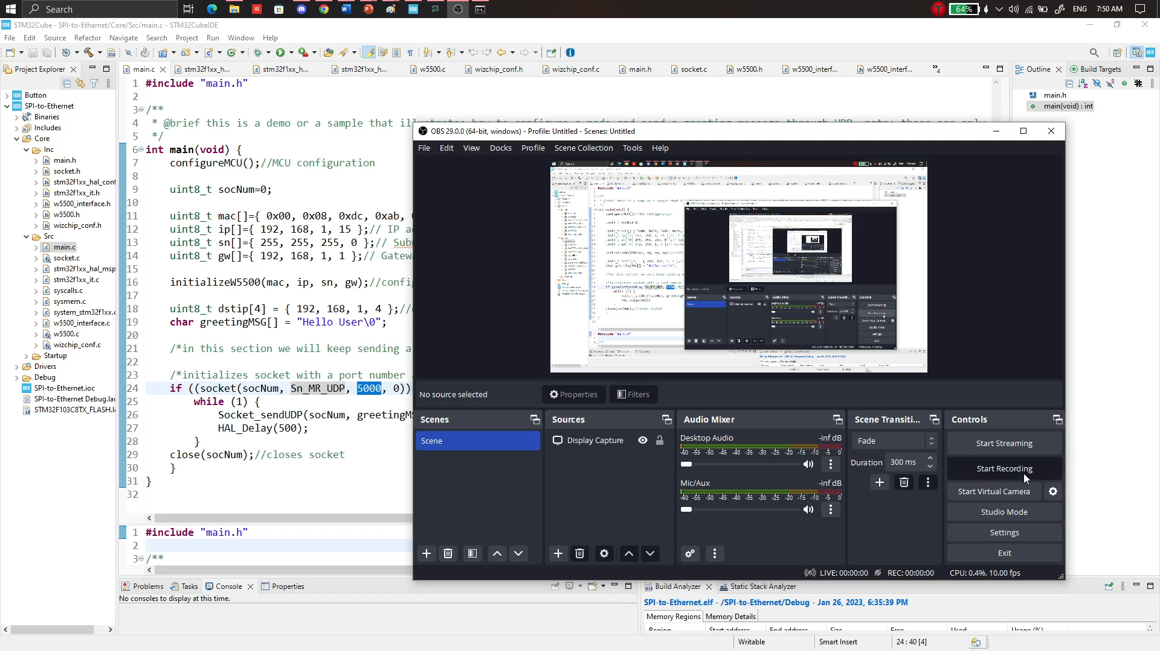
Video demonstration

